Slide 1

AIM-AHEAD Introductory Courses in AI/ML Concepts
Module 6: Natural Language Processing
Text Classification
Adapted from the Health Informatics and Data Science Masters Degree Program, Georgetown University

Slide 2
Text Classification
Convolutional Neural Nets (CNN)
Notes:
In this lesson, we are going to talk about text classification using convolutional neural networks.

Slide 3
Motivation
We already have word vectors.
Can we use these to come up with a way to represent the sentence and classify it ?
Eg :- “the patient was given immuno therapy”
We have vectors for “the”, “patient”, “was”, “given”, …“therapy”.
How can we use the vectors for words to get vector for sentence ?
Notes:
In a previous lesson, we learned about how we can generate word vectors, or embeddings, based on the context it is used in text.
But can we go further and build a vector representation of a sentence?
For example, take the sentence, “The patient was given immunotherapy.”
We have individual vectors for each of the words, but how can we use those to create a vector representation of the sentence?

Slide 4
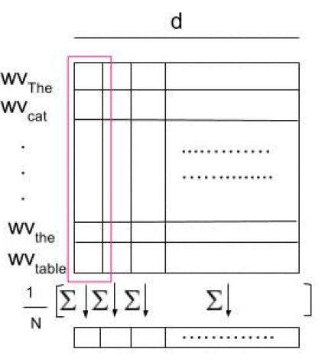
Trivial Approaches
Apply simple reduction techniques to generate vectors/features for the sentence and then apply any well-known ML model (LR, SVM ..)
Mean of word vectors
Notes:
One simple approach is to apply a reduction technique.
That is to say, we take the mean of individual features of the embeddings of all the words in the sentence.
In the example, the embedding spans horizontally and each word is stacked on top of each other.
Each value of the embedding is averaged to compute the sentence representation.

Slide 5
Fallacies
Different sentences with same words but different ordering will give same vector.
“are you good” vs “you are good”
Negation - opposite meaning but very similar words
“I do want a car” vs “I don’t want a car”
Sentence vector generated via simple operations on word vectors - often do not capture syntactic and semantics properties.
Notes:
However this causes several issues.
For one, the ordering of the sentence does not matter. The embeddings for “Are you good” will average to the same representation as the phrase “you are good.”
Also, negation doesn’t have a large impact on the sentence representation.
For example, in the sentences “I do want a car” and “I don’t want a car”, 4 out of 5 words will contribute the same to the sentence embedding, resulting in similar embeddings for opposite meaning sentences.
The embeddings generated from a simple operation on the word vectors often don’t capture the important nuances of language, like syntax and semantics.

Slide 6
Solution: Convolutional Neural Nets
CovNet or CNN
CNN were initially developed in the neural network image processing community
Recognizing an object from a pre-defined category (e.g., cat, bicycle, etc.).
CNN typically involves two operations, which can be thought of as feature extractors that work on 2D input
convolution
pooling
Notes:
The solution is to use Convolutional Neural Networks, or CNNs.
The CNN architecture was initially developed for image processing, where is was used to classify the objects in an image.
Image data is organized into uniform columns and rows, like the pixels of an image.
A sentence can be organized in a similar way, with words making up the rows and the embeddings making up the columns.
There are two main operations in CNNs, which can be thought of feature extractors on 2D input.
Convolution applies filters to input data to extract features, while pooling reduces the dimensionality of the data by summarizing regions.

Slide 7
Convolutional Neural Nets (CNN)
Motivation through Image Classification
Notes:
Let’s look at an example from image classification to motivate the application of CNNs to text.

Slide 8
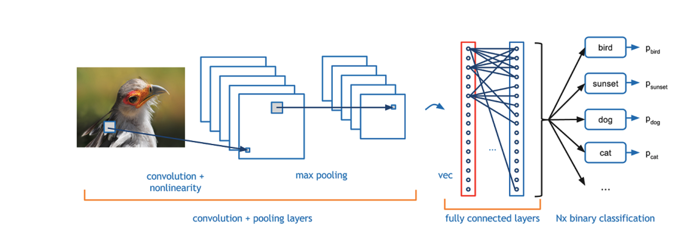
CNN Architecture for Image Classification
Notes:
In a typical CNN, the image is first processed by several convolutional layers, each applying filters to detect features like edges and textures.
These are followed by pooling layers that downsample the feature maps, reducing their size while retaining important information.
After several rounds of convolution and pooling, the output is flattened and passed through fully connected layers.
The fully connected layers combine the extracted features to make a final prediction in the classification layer, assigning probabilities to different classes.
Let’s break that down a bit more.

Slide 9
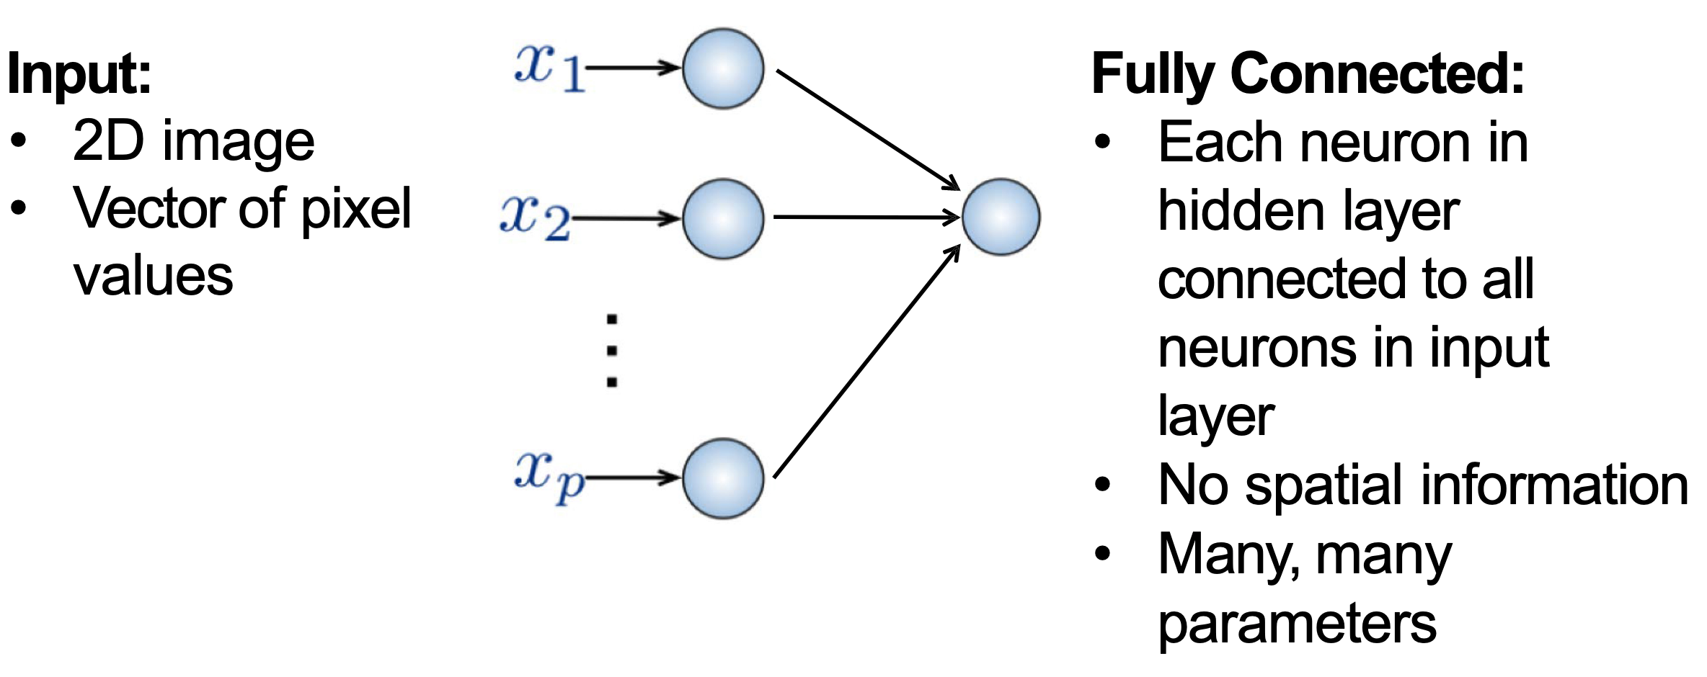
Traditional Fully Connected Neural Network
Use local spatial structure of the 2D input
Notes:
In a traditional neural network made of fully connected layers, the 2D image can only be represented by a vector of pixel values.
This results in the representation being row by row of the image, and all spatial information is lost.
This type of model architecture also needs many parameters to fully connect all the neurons.

Slide 10
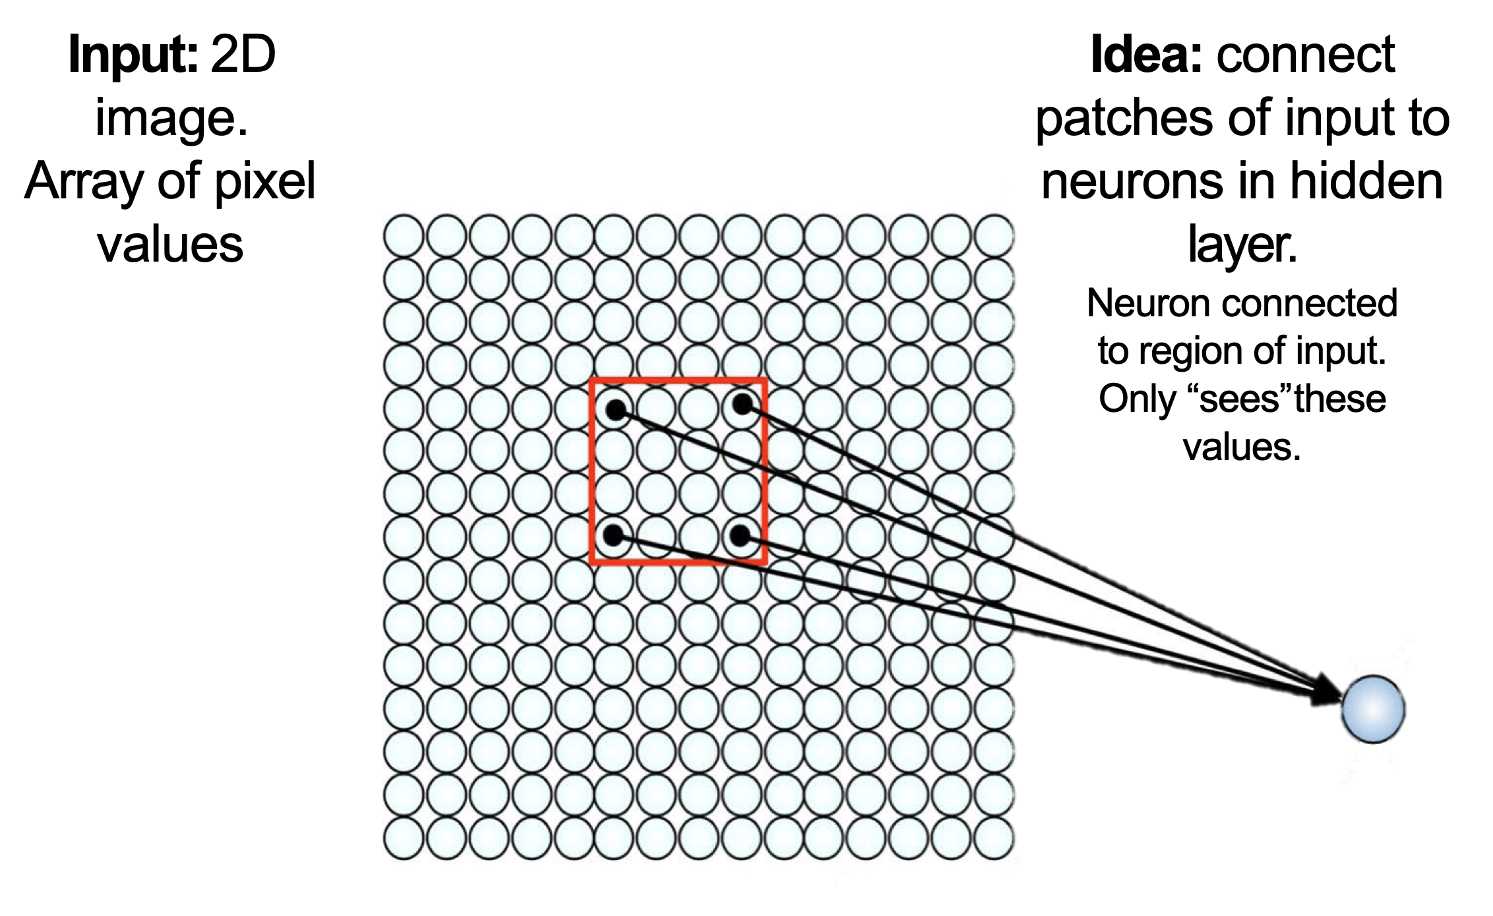
CNN Intuition: Compute Local Spatial features
Notes:
Here we see an enlarged segment of an image, where the circles represent individual pixels.
The red patch is showing a local region of the image that is connected to a neuron in a hidden layer.
In this way, the spatial relationships between pixels is preserved, and the neuron connected to a region of the input only ‘sees’ these values,” emphasizing the localized receptive field concept in convolutional neural networks

Slide 11
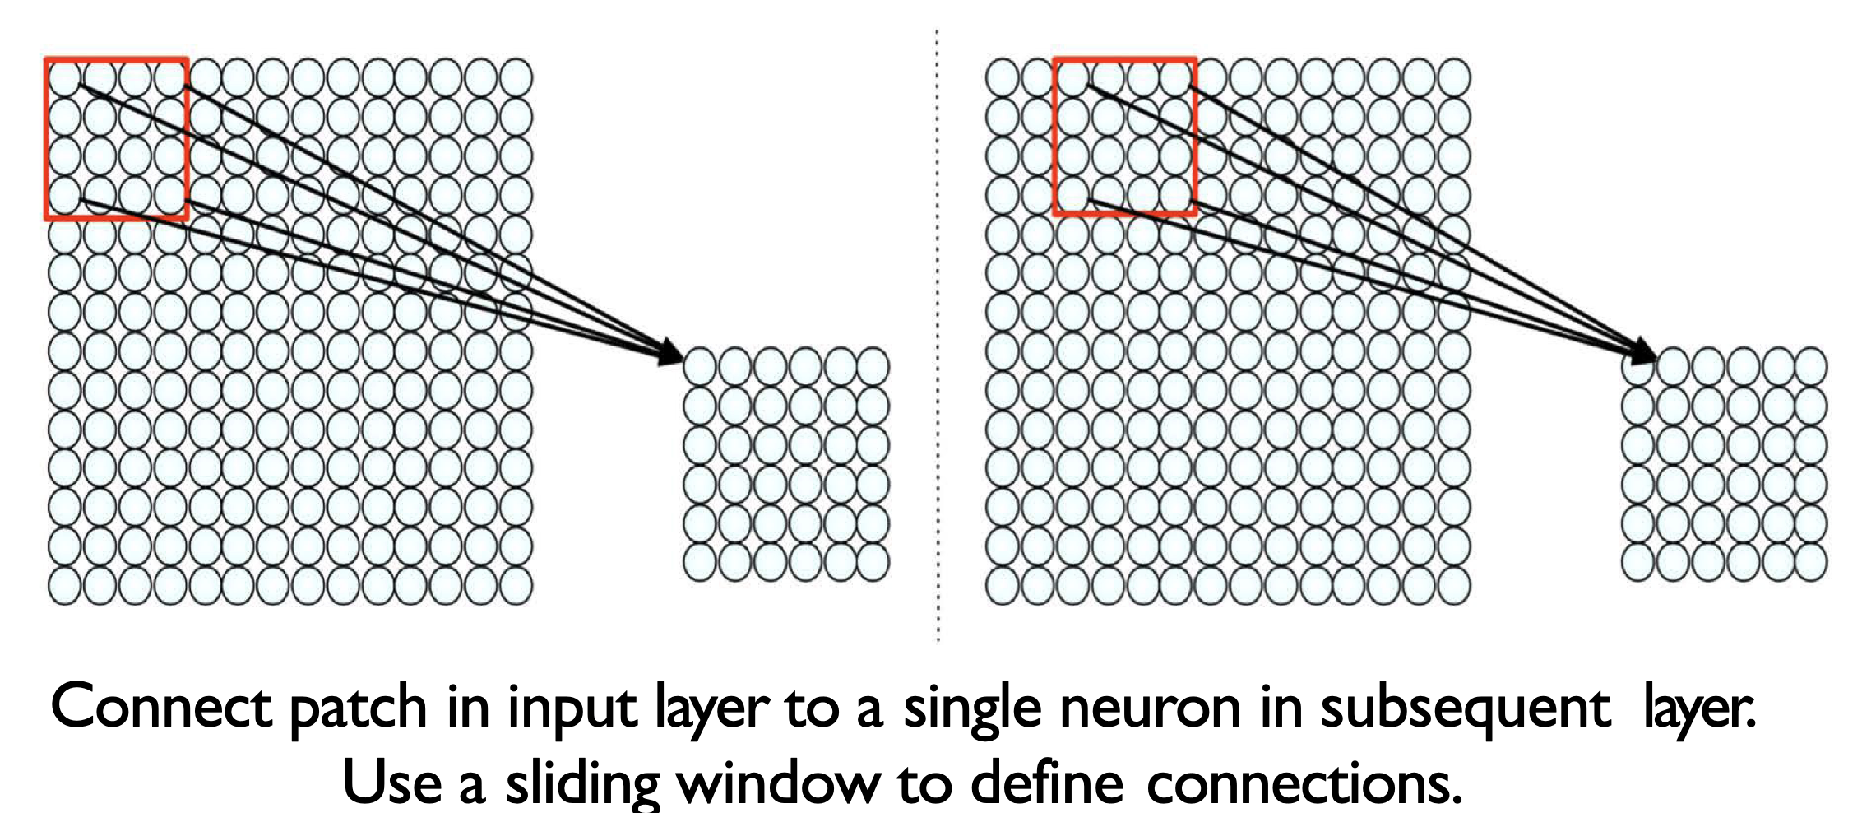
CNN Intuition: Convoluted features
Notes:
The convolution is applied over the whole image as a sliding window.
Each patch is connected to a single neuron in the hidden layer.
The hidden layer after a convolution layer is often called a feature map or activation map.

Slide 12
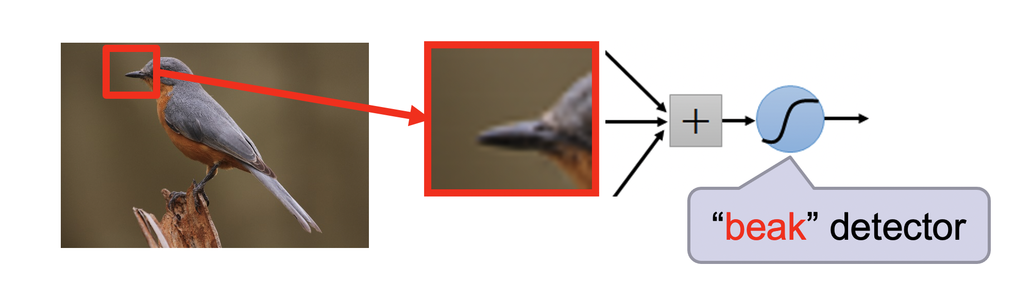
Convoluted features: High Level Feature
Notes:
The hidden layer contains neurons that each respond to specific features detected by the convolution filters.
These neurons capture patterns such as edges, textures, or other local features from the input image, and their activations represent the presence and strength of these features in different spatial locations of the input.
For example, one convolutional layer may detect the presence of a beak within a patch of the image.

Slide 13
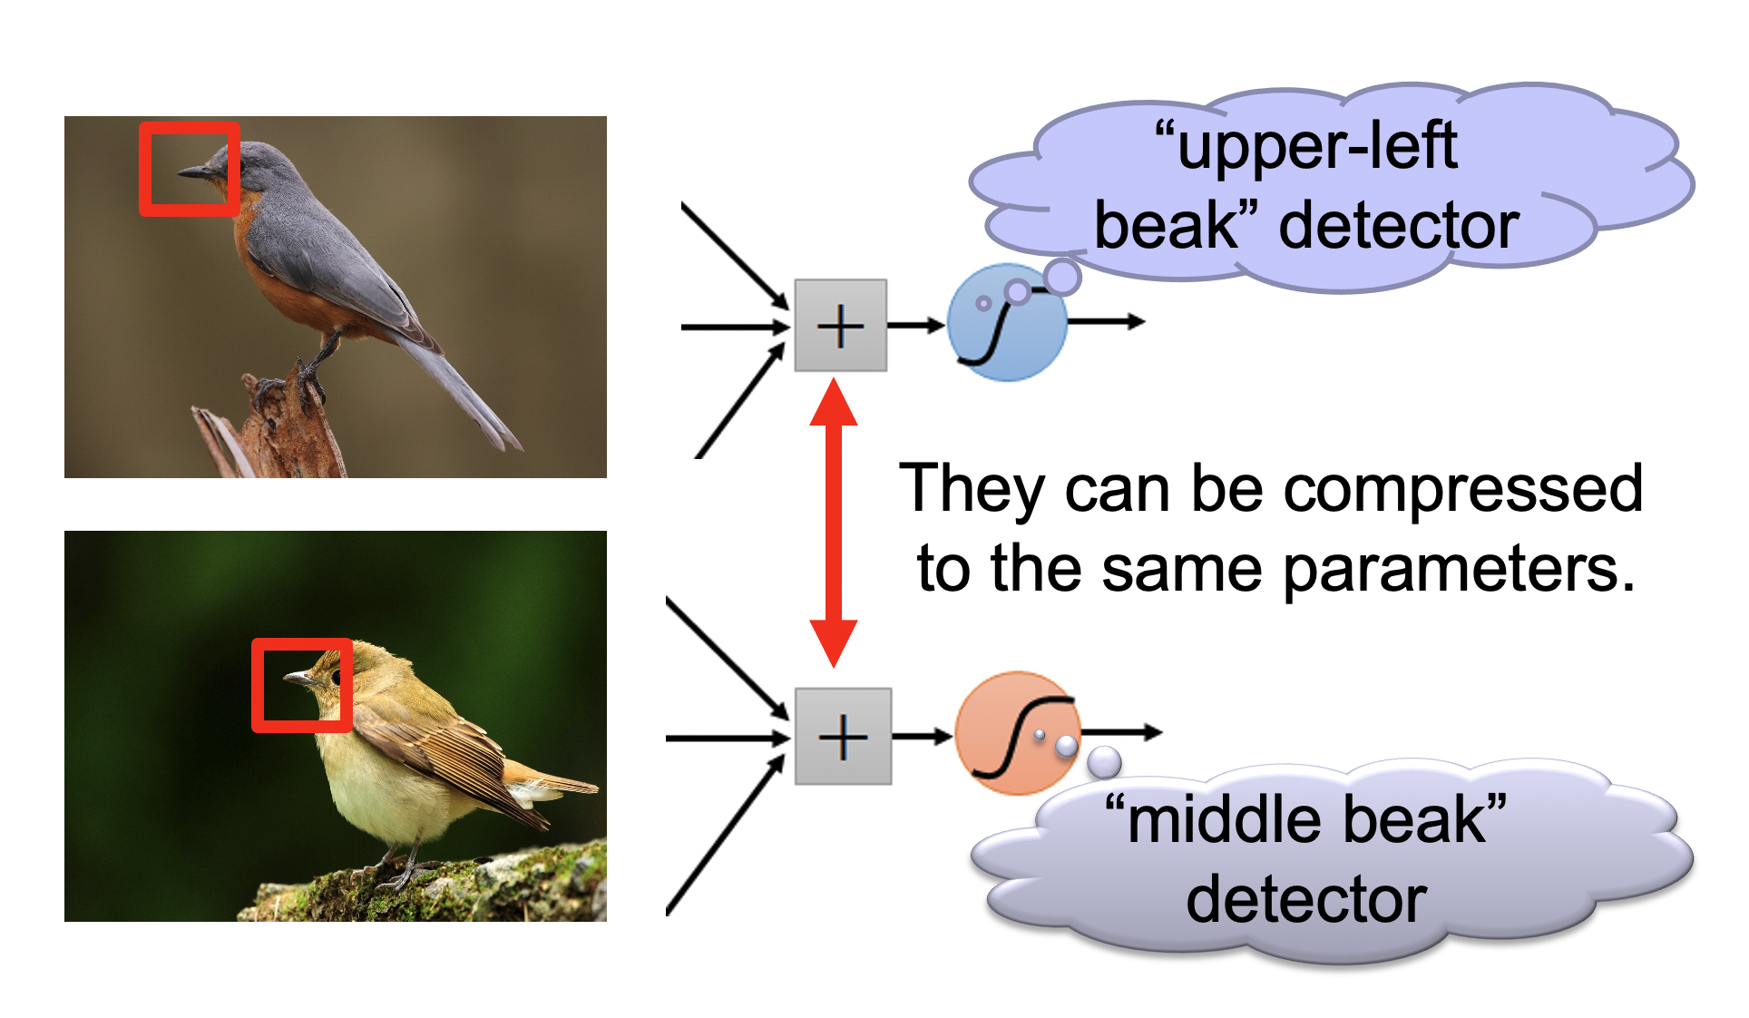
Multiple Convolutions
Hand written digit CNN demo: https://adamharley.com/nn_vis/
Notes:
Using multiple convolution layers in a neural network allows the model to learn increasingly complex and abstract features from the input data.
The initial layers might detect simple patterns like edges and textures, while deeper layers can combine these simple features to recognize more complex structures, such as shapes or even entire objects.
This hierarchical feature extraction enables the network to build a more detailed and nuanced understanding of the input, improving its performance on tasks like image classification and object detection.

Slide 14
Convolution
A filter (2D) of some size slides over the 2D data
This filter is 2D matrix of weights
Each sliding operation => dot product => one scalar value
After all sliding operations => a 2D convoluted feature = > some local feature
Automatic feature generation
Learns some aspects of the input (image, text)
Notes:
Convolution can be though of as some 2D filter that slides over the 2D data.
The filter is a matrix of weights, and these weights are integrated over the filter to produce a single scalar value.
The result of sliding the filter across the entire dataset produces a 2D convoluted feature representing some local property of the image.
When the weights of the filter are learned though training, this leads to automatic feature generation, where different convolutional layers can be identified.

Slide 15
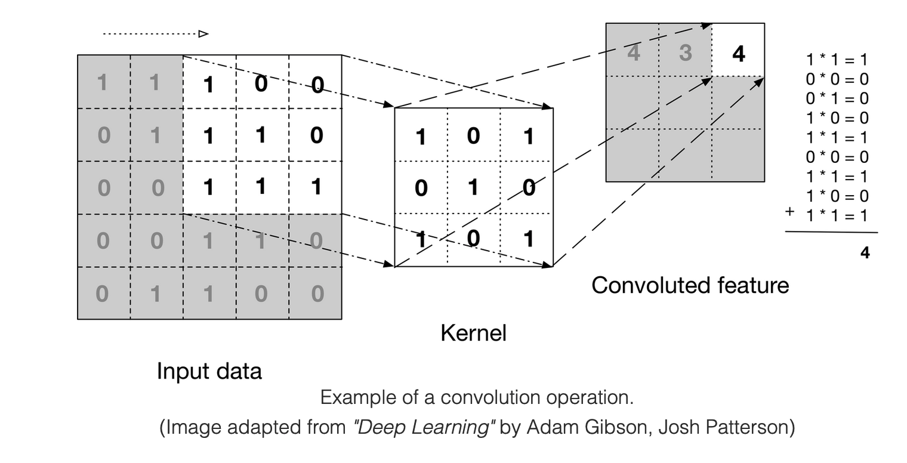
Convolution Example
Notes:
Here is a visual example.
The input data is a 5x5 array of pixels, with values of 1 or 0.
Our filter, or Kernel, is defined as a 3x3 array, with the weights as shown.
When this filter is applied to a portion of the input data, the weights are multiplied by the pixel values, and summed into a single value.
As the filter slides over the image, a smaller 2D array is populated with the convoluted features.

Slide 16

Sliding operation: Example
Notes:
Here is another representation.
The filter from the previous slide is applied to the first segment of the image.
The result is the value of 4 in the first position of the convolved feature matrix.

Slide 17
Pooling
After obtaining features using convolution, we would next like to use them for classification.
But there will be a lot of convoluted features, because
We typically use a lot of different convolution kernels (128, 256..)
Of different sizes (3, 5, 7 ..)
Learning a classifier with these many convoluted features (typically in millions) is computationally slow and prone to overfitting
Solution: Pooling
Notes:
We would next like to use the convolved features for classification.
There will be a lot of convoluted features because a large number of different convolution kernels (128, 256, etc.) of various sizes (3, 5, 7, etc.) are used in a CNN.
Learning a classifier with these many convoluted features, which typically number in the millions, is computationally slow and prone to overfitting.
The solution to this problem is pooling.

Slide 18
Pooling
convolved features => “stationarity” property of a subset of input
Pooling => aggregate statistics of these features at various locations
Compute the mean (or max) value of a particular feature over a region of the image.
Notes:
When we extract features using convolution, we leverage the “stationarity” property of a subset of the input.
This means that certain features remain consistent across different parts of the image.
To make use of these convolved features for further processing, we apply pooling, which helps aggregate statistics of these features at various locations in the image.
Pooling involves computing the mean or maximum value of a particular feature over a specific region of the image.
This process reduces the dimensionality of the feature maps while retaining the most important information, making the subsequent layers more efficient and less prone to overfitting.
By summarizing the presence of features in different regions, pooling helps the neural network focus on the most relevant patterns, enhancing its ability to classify and recognize objects accurately.

Slide 19
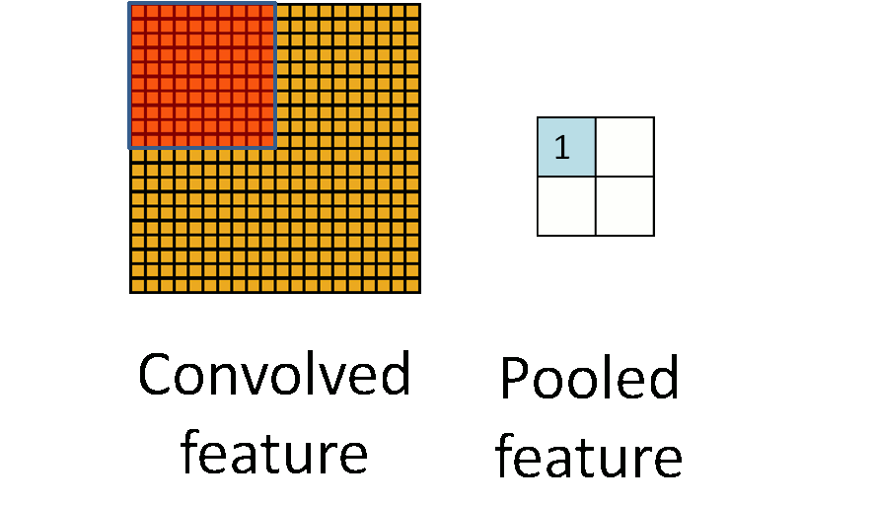
Pooling
Notes:
In this example, the convolved features in the upper left of the image are all activated while the remaining features are not.
The pooled feature reduced the image down to a 2x2 representation that shows the average within the pooled region.

Slide 20
CNN for Text classification
Notes:
So how can we apply CNNs for text classification?

Slide 21
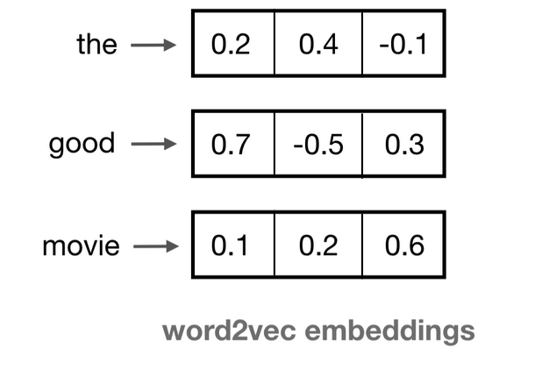
Input: Embedding Space
A 2D matrix, where each word is represented by a fixed dimension vector
Notes:
From the perspective of the data, we can represent a sentence the same as an image.
That is, we can arrange the feature embeddings into a 2D matrix and use it as input to a CNN.

Slide 22
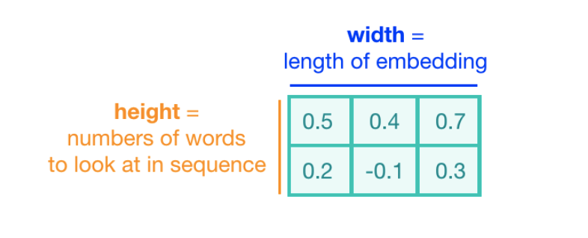
Convolution Kernel
The height of the kernel will be the number of embeddings it will see at once, similar to representing an n-gram in a word model => kernel size (2 here)
The width of the kernel should span the length of an entire word embedding.
Notes:
When defining the Kernels that are applied to the 2D sentence embedding, the width is fixed to the length of the embedding.
The height of the kernel represents how many words are looked at to generate the convolved feature.
The main difference from image analysis is that kernel doesn’t slide over the length of the embedding, only over the words in the sequence.

Slide 23
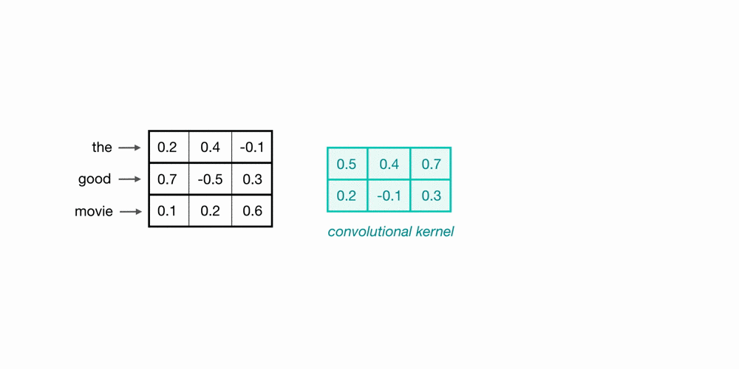
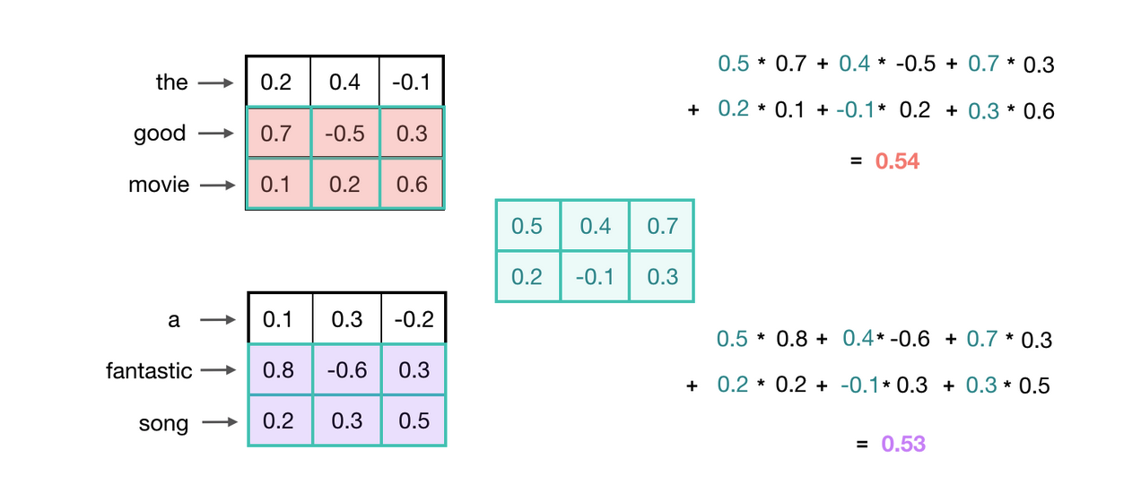
Convolution over Word Sequences
Kernel size = 2
What is this particular convolution step learning?
Notes:
Here we see a kernel of size 2 being applied to the phrase “the good movie”
What does a kernel with size 2 learn?
It characterized the relationship between adjacent words, which are also known as bigrams.
Here the kernel is being applied to the bigram “good movie”.

Slide 24
Recognizing General Patterns
Notes:
In text analysis, bigrams help identify common word pairs and patterns within a body of text. This can be useful for tasks like:
Sentiment Analysis: Understanding the sentiment behind phrases. For example, “not good” has a different sentiment than “very good,” and bigrams help capture this nuance.
Topic Modeling: Identifying topics within a text by looking at frequently occurring bigrams, which can indicate key themes or subjects.

Slide 25
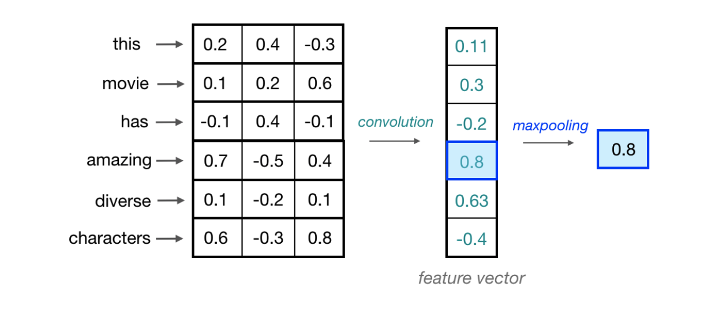
Maxpooling over time
Notes:
The kernel is applied to the sentence to produce the feature vector.
And in a similar way to image analysis, a pooling layer is applied to the convolved features to preserve the most significant information.

Slide 26
Multiple Kernels
One convolutional kernel is not enough to detect all the different kinds of features that will be useful for a classification task.
Need multiple kernel of different sizes to automatically learn local features
Typical kernel sizes: 3, 5, 7,
Number of kernels: 64, 128, 256, 512
Notes:
To effectively detect the diverse range of features necessary for a classification task, relying on a single convolutional kernel is insufficient.
Instead, multiple kernels of varying sizes are required to automatically learn and capture local features from the input data.
Typical kernel sizes include 3, 5, and 7, while the number of kernels can range from 64 to 512.
This variety allows the network to identify and combine different patterns, enhancing its ability to accurately classify and recognize complex inputs.

